Slide 1
JAY SIR
Subhamay Dey
History - VIII – XII
Geography - VIII – X
Visual Storyteller
8 Yrs Exp. & Detail Oriented
Caring Like Elder Brother
Loves Teaching
His diligent care helped Trisha score so well !
– Trisha’s mother
Explains well, takes tests & clears all doubts. Excellent!
– Emon Kalsa’s mother

Slide 2
JAY SIR
Subhamay Dey
Accountancy & Business Studies - VIII – XII
Visual Storyteller
8 Yrs Exp. & Detail Oriented
Caring Like Elder Brother
Loves Teaching
His diligent care helped Trisha score so well !
– Trisha’s mother
Explains well, takes tests & clears all doubts. Excellent!
– Emon Kalsa’s mother

Slide 3
Dipanwita Biswas
M.A. (English), B.Ed.
English - VIII
Motherly & Empathetic
Innovative Techniques
Diligent & Adaptive
16 Yrs Experienced
Excellent teacher, I owe so much to this wonderful lady for my career!
– Susanta Das, ex student

Slide 4
Anirban Chakrabarty B.E. (Electronics), M.B.A. (Finance)
C.E.O, H.O.D, AI & Robotics
Supportive, Loves Kids
Global Corporate Exp.
Innovative & Dynamic
Truly Inspires Talent
Super brain, the best guy to take care of AI implementation!
– Corporate Client
Dynamo of energy, dependable and trusted for the job!
– Vish Coosa, Morgan Stanley Bank, U.S.A.

Slide 5
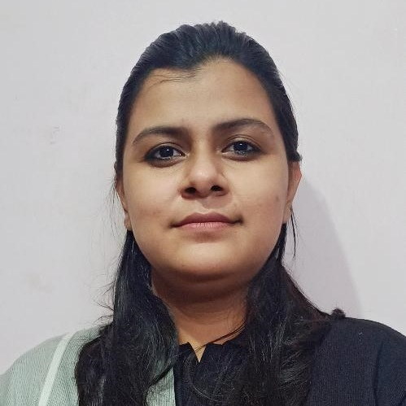
Abhipsha Dutta
M.Sc., B.Ed.
Chemistry - VIII – XII
Excellent Mentor
Great Academics
Caring & Meticulous
Brilliant Experience
Explains so well and clears all doubts. I am really happy!
– Suparno’s mother (ICSE 97%)

Slide 6

Avishek Sir
Avishek Adhikari
Maths - VIII – XII
Cracked IIT
8 Yrs Exp. & Detail Oriented
Lots of Successful Students
$\frac{100}{100}$ in Maths in HS & 10th
B.Sc. Math CU 1st Class 1st
M.Sc. Math CU 1st Class 1st
Neel depended on him so much to score !
– Neel’s mother
Explains well, takes tests & clears all doubts. Excellent!
– Emon Kalsa’s mother

Slide 7
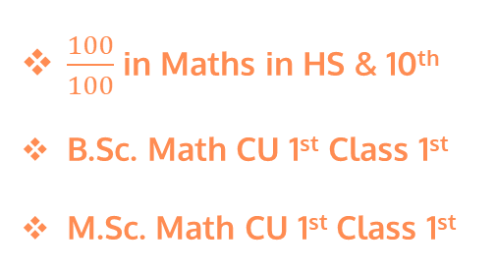
Avishek Sir
Avishek Adhikari
Physics - VIII – XII
Cracked IIT, ISI PhD (Ongoing)
8 Yrs Exp. & Detail Oriented
Lots of Successful Students
$\frac{100}{100}$ in Maths in HS & 10th
B.Sc. Math CU 1st Class 1st
M.Sc. Math CU 1st Class 1st
Neel depended on him so much to score !
– Neel’s mother
Explains well, takes tests & clears all doubts. Excellent!
– Emon Kalsa’s mother

Slide 8
Arijit Sir
Arijit Bhattacharya
accountancy - IX – XII (All Boards)
Taught in Gurukul Ins.
5 Yrs Exp. & Detail Oriented
Lots of Successful Students
Expertise & Organised
Classroom Management

Slide 9
Anupam Sen
H.O.D, Commerce
Loves to Teach
35 Yrs Corporate Exp.
Grass Root to Board Room
Friendly Caring, Mentor
Lucid Storytelling Teaching

Slide 10
Debashish Sir
Debashish Nath
H.O.D. IT
Ex Best Faculty in CMC
Great Problem Solver
Teach with Patience
Experienced
Walks extra mile to make difficult concept seem cake walk
– IT Head of Recent Engagement
– IT Head of Recent Engagement

Slide 11
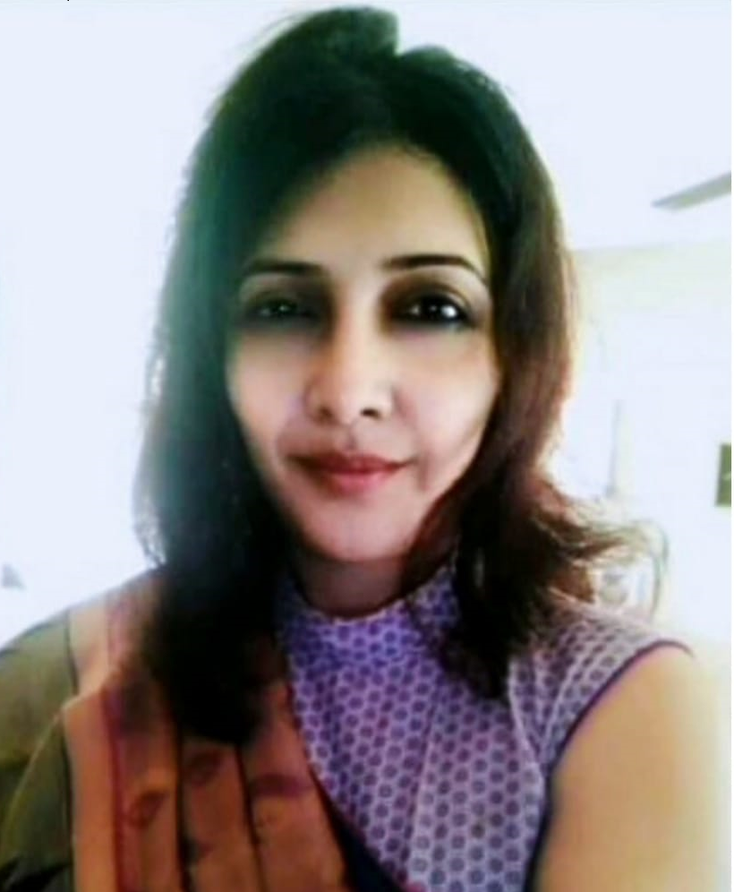
Pradipta Ma’am
Pradipta Bose
Teach like Motherly
25 Yrs, Experienced
Personality Developer
Behave More Patiently

Slide 12
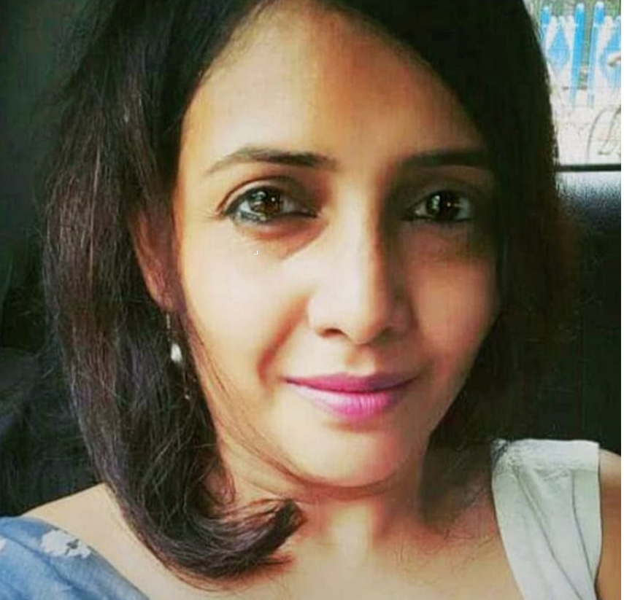
Pradipta Ma’am
Pradipta Bose
Pay Attention to Each One
Understand the Student Psychology
Energy & enthusiasm
Expertise

